Slide 1
Internet & Web
Lab 10:Introduction to Web

Slide 2
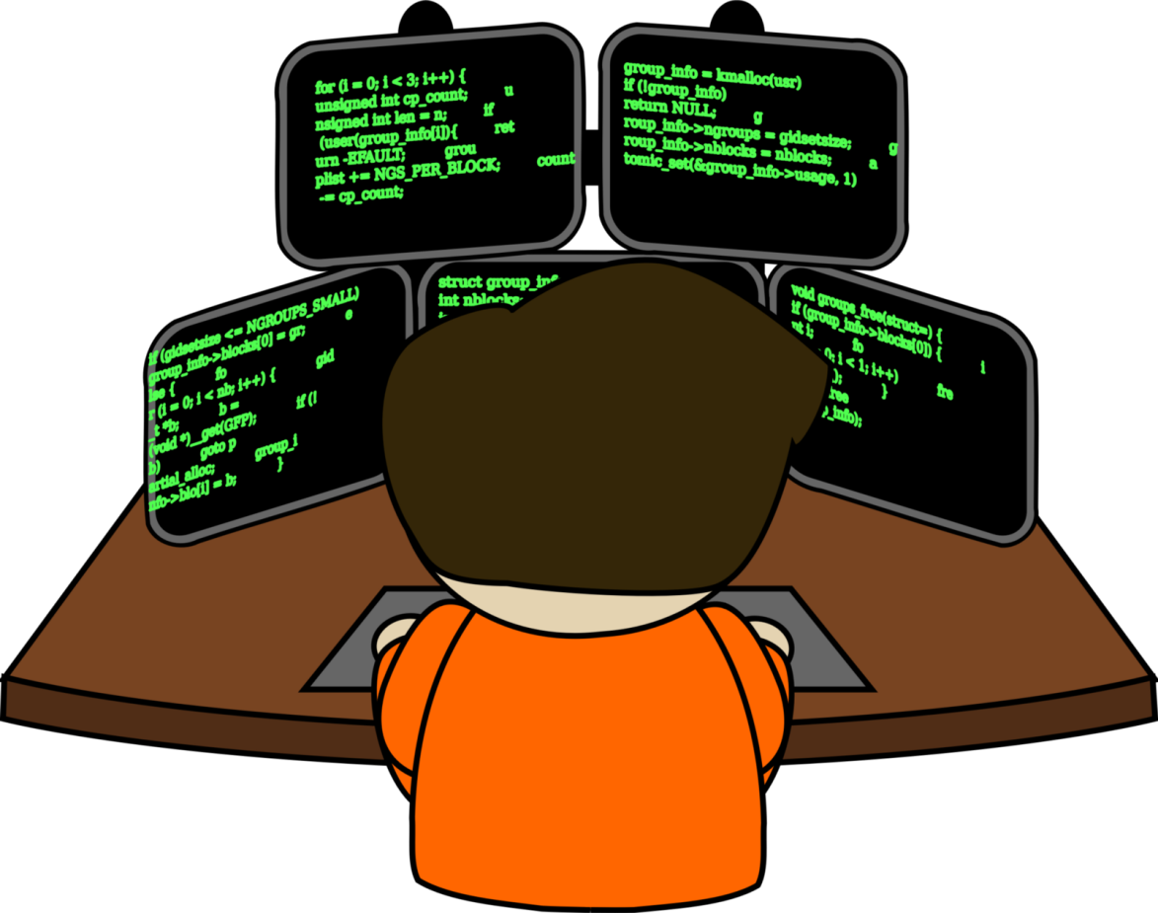

Welcome to Internet & Web Class

Slide 3


Web
A network of online content that is formatted in HTML and accessed via HTTP.
A way of accessing information over the medium of the internet.

Slide 4

Website
A collection of related web pages, including multimedia content, typically identified with a common domain name, and published on at least one web server
Ex: Wikipedia, LinkedIn.

Slide 5
Webpage
The building block of Website. Website is made up with multiple webpage.
There are two type of websites based on its webpage’s behavior. They are-
Static- Content is fixed.
Dynamic- Content is responsive and may change.

Slide 6
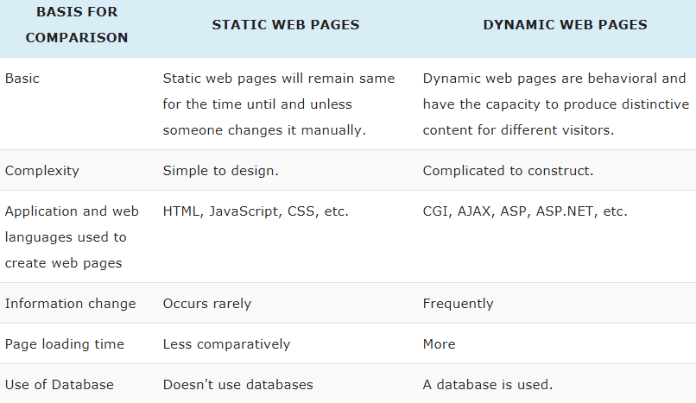
Static Vs Dynamic

Slide 7
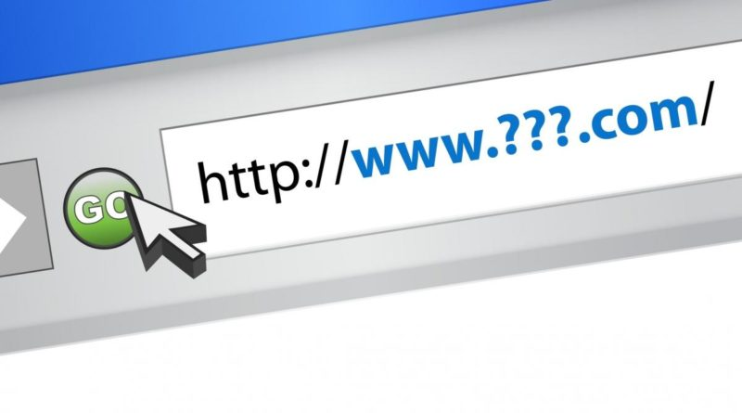
Domain Name
A human friendly way to locate/define a website on internet.

Slide 8
Domain Name
Every domain name has a suffix that indicates which top level domain (TLD) it belongs to. There are only a limited number of such domains.
.gov - Government agencies
.edu - Educational institutions
.org - Organizations (nonprofit)
.com - commercial business
.ca - Canada
.th – Thailand
.bd -Bangladesh
.mil – Military
.net - Network organizations

Slide 9

Today’s learning:
Concept of Web
Website, Webpage
Domain Name
Thank You!

